Slide 1

CS 533 INTRO TO DATA SCIENCE
Michael Ekstrand

Slide 2
CONTINUOUS PROBABILITY AND RANDOM VARIABLES

Slide 3

Learning Outcomes
Compute an expected value
Understand why continuous events have probability densities, and the relationship to distribution functions
Photo by Roepers on Wikimedia Commons. CC-BY 3.0.

Slide 4
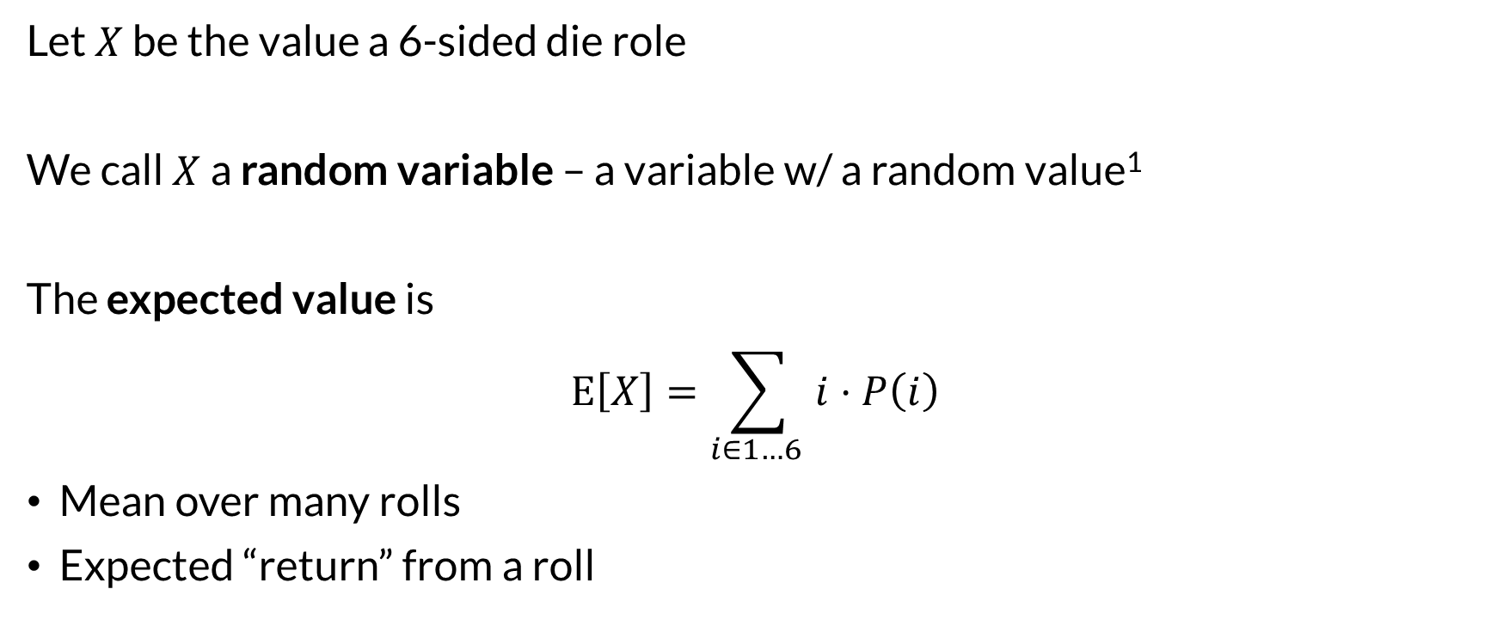
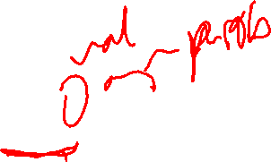
Random Variable
Let $X$ be the value a 6-sided die role
We call $X$ a random variable – a variable w/ a random value¹
The expected value is
$$E\left[X\right]=\sum_{i∈1…6 }{i⋅P\left(i\right)}$$
Mean over many rolls
Expected “return” from a roll
¹ Technically, a random variable is a function $f_{x}:E→ℝ$ from elementary events to numeric values.

Slide 5
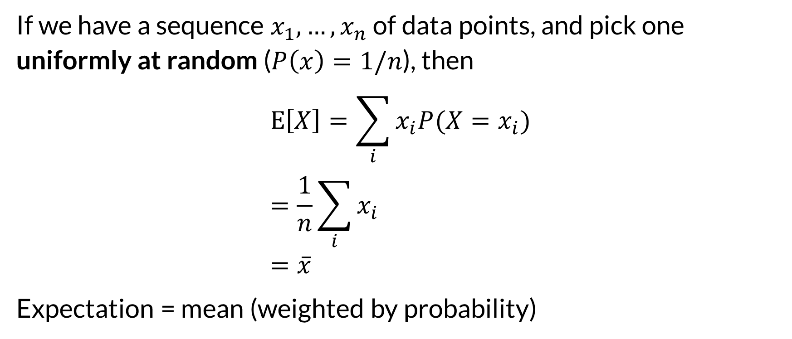

Expectation and Mean
If we have a sequence $x_{1},…,x_{n}$ of data points, and pick one uniformly at random ($P\left(x\right)=1/n$), then
$$E\left[X\right]=\sum_{i}{x_{i}P(X=x_{i})} \\ =\frac{1}{n}\sum_{i}{x_{i}} \\ =\overline{x}$$
Expectation = mean (weighted by probability)

Slide 6
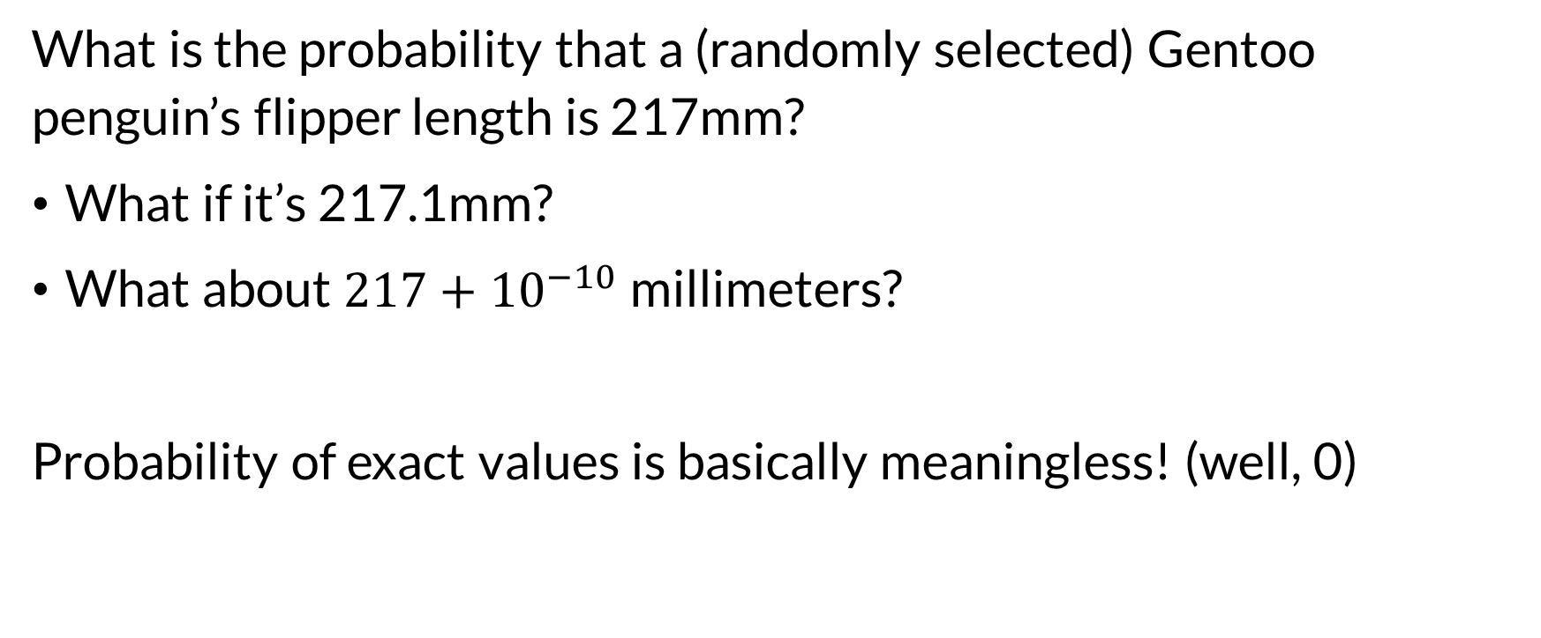
Continuous Variables
What is the probability that a (randomly selected) Gentoo penguin’s flipper length is 217mm?
What if it’s 217.1mm?
What about $217+{10}^{−10}$ millimeters?
Probability of exact values is basically meaningless! (well, 0)

Slide 7
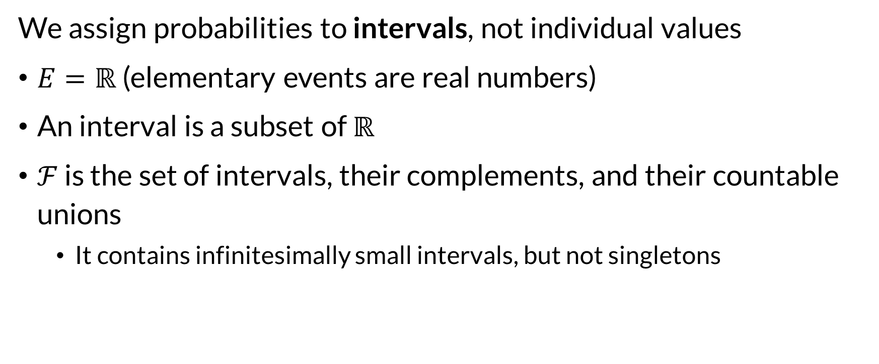
Continuous Variables
We assign probabilities to intervals, not individual values
$E=ℝ$ (elementary events are real numbers)
An interval is a subset of $ℝ$
$ℱ$ is the set of intervals, their complements, and their countable unions
It contains infinitesimally small intervals, but not singletons

Slide 8
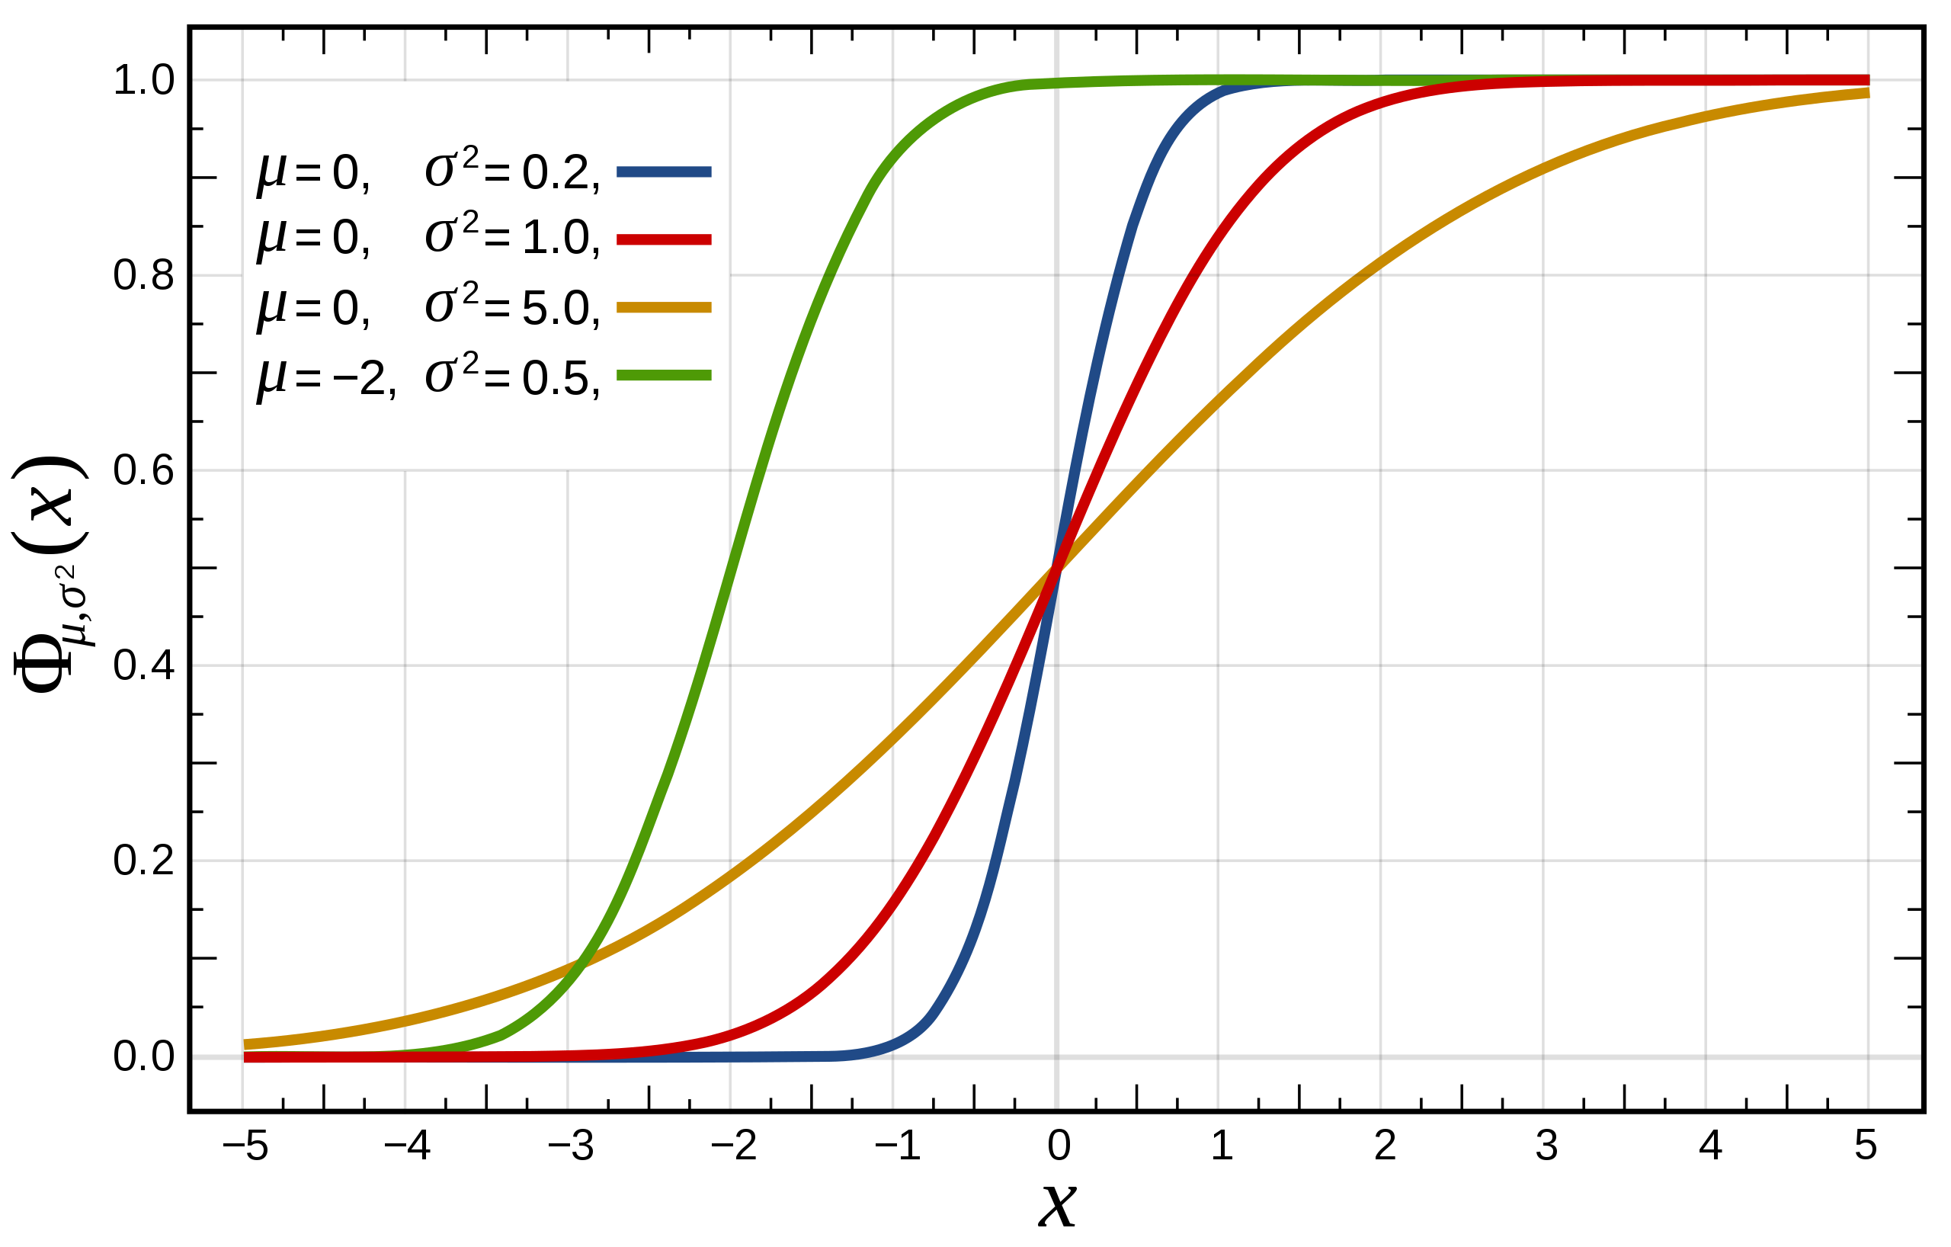

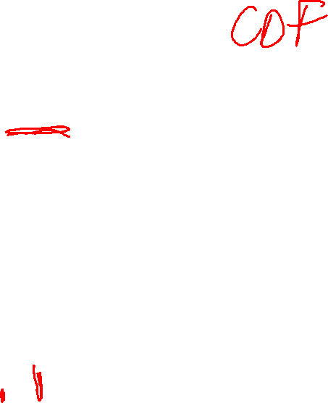
Continuous Probability
Continuous probabilities have a distribution function:
$$F\left(x\right)=P\left(X<x\right)$$
Figure from Wikipedia.

Slide 9
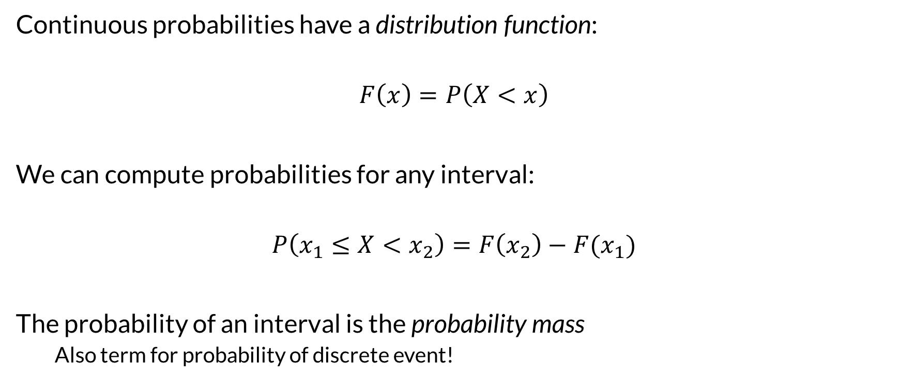

Continuous Probability
Continuous probabilities have a distribution function:
$$F\left(x\right)=P\left(X<x\right)$$
We can compute probabilities for any interval:
$$P\left(x_{1}≤X<x_{2}\right)=F\left(x_{2}\right)−F(x_{1})$$
The probability of an interval is the probability mass
Also term for probability of discrete event!

Slide 10
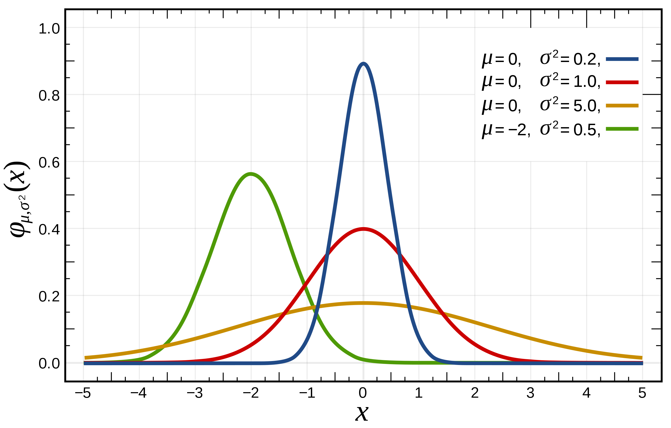

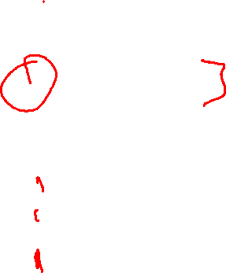
Probability Density
Distributions are often defined by a density function $p$ such that
$$F\left(x\right)=\int_{−∞}^{x}{p\left(x\right) dx}$$
Figure from Wikipedia.

Slide 11
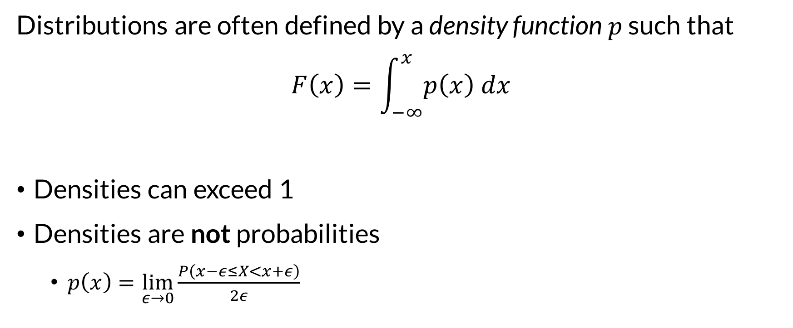
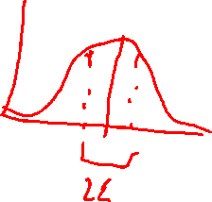
Probability Density
Distributions are often defined by a density function $p$ such that
$$F\left(x\right)=\int_{−∞}^{x}{p\left(x\right) dx}$$
Densities can exceed 1
Densities are not probabilities
$p\left(x\right)=\lim_{ε→0}{\frac{P\left(x−ε≤X<x+ε\right)}{2ε}}$

Slide 12

Continuous Expectation
Expectation of continuous random variables is mean, weighted by density:
$$E\left[X\right]=\int{x p\left(x\right) dx}$$

Slide 13

Wrapping Up
The probability of any single value of a continuous variable is effectively zero.
Instead, we use probability density, distribution functions, and assign probability to intervals.
Expectation is the mean of a random variable.
Photo by Andrés Dallimonti on Unsplash

